Slide 1

GLOBAL SALES REPORT
(2022-2023)
Presented by:
Name : Damarasingu Gowtham Bhaskar
CMIS ID : AF0426119
BATCH : ANP-C8412

Slide 2
INDEX
Abstract
Dashboard
Regional Sales
Regional Sales Result
Monthly Sales
Monthly Sales Result
Category Sales
Category Sales Result
Country Sales
Country Sales Result
Conclusion

Slide 3
ABSTRACT
This presentation provides a comprehensive analysis of global sales, examining various countries and regions while categorizing data into distinct product segments. By highlighting total sales figures and profit margins, The Project aims to identify key trends, regional performance, and potential growth opportunities within the international marketplace.

Slide 4
DASHBOARD
A dashboard in Power BI is a single-page, interactive visual display that consolidates key metrics and insights from multiple reports and datasets. It allows users to quickly monitor performance, track trends, and make data-driven decisions by presenting visualizations like charts, graphs, and KPIs in a user-friendly format. Dashboards are customizable, enabling users to focus on the most relevant information for their specific needs.

Slide 5
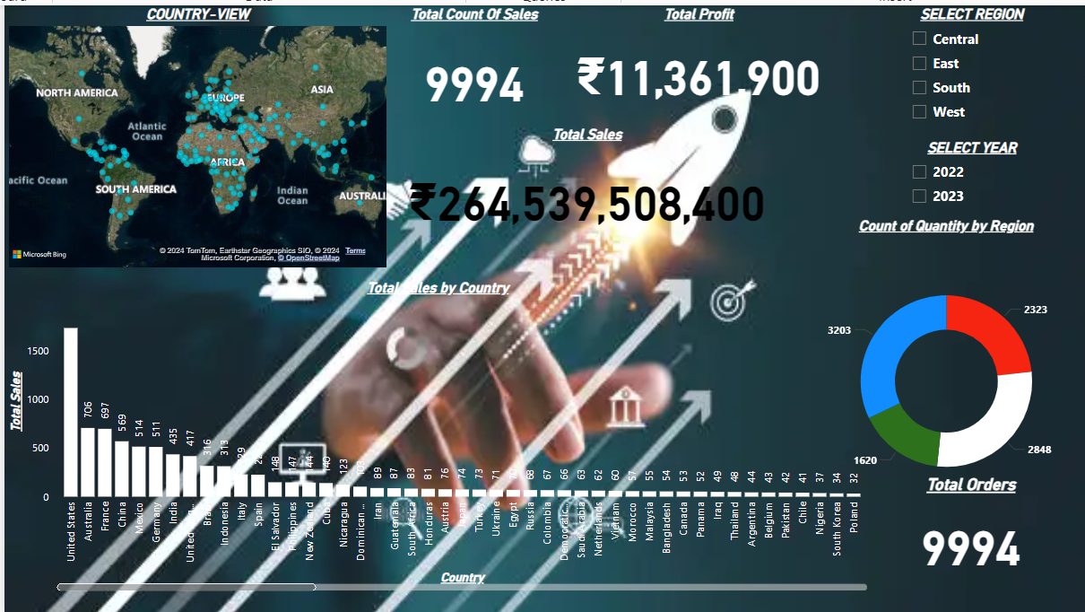
REGIONAL SALES
Regional sales analysis involves selecting a specific region and year to generate a report that provides insights into sales performance. This report displays the total profits, the sum of sales, and the count of total orders within the selected region. By focusing on these metrics, users can evaluate the effectiveness of sales strategies and identify opportunities for growth in that particular area.

Slide 6
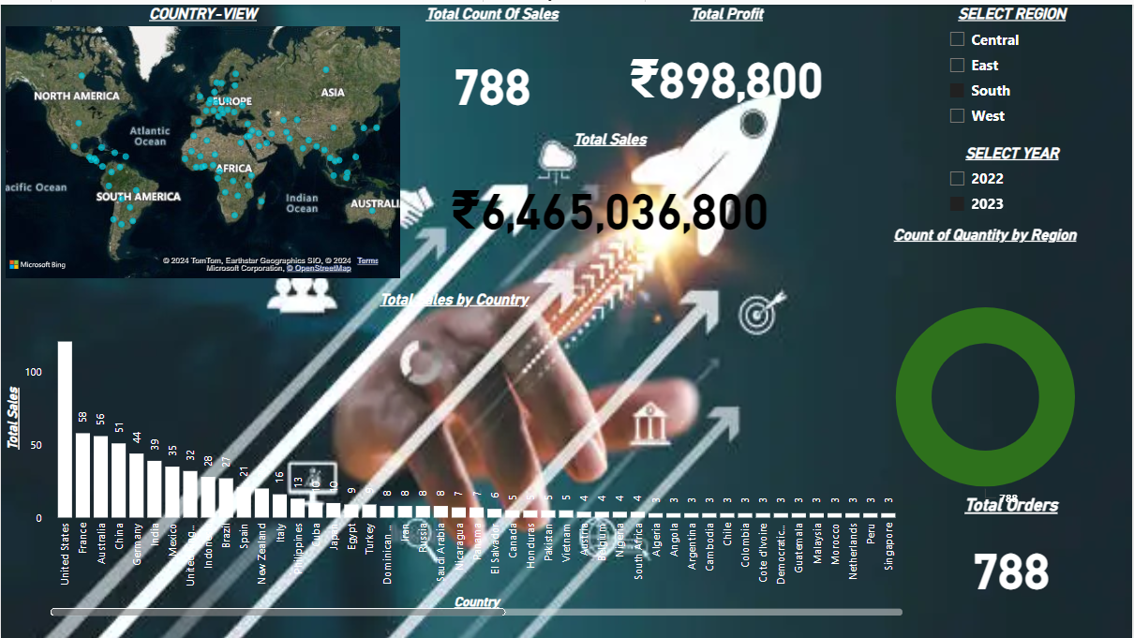
REGIONAL SALES RESULT
HERE IS THE RESULT FOR PREVIOUS VISUAL

Slide 7
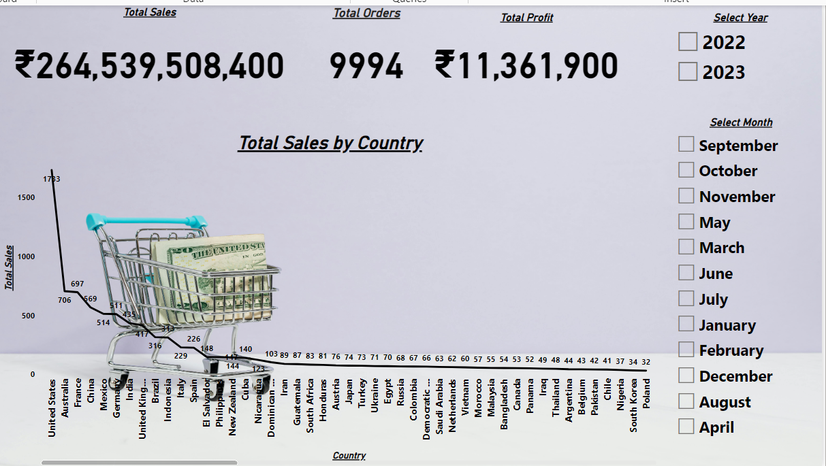
MONTHLY SALES
Monthly sales analysis involves selecting a specific month and year to generate a detailed report. This report displays key metrics such as total sales revenue, profits, and the count of total orders for each month within the selected region. By breaking down performance month-by-month, users can identify seasonal trends, assess sales strategies, and pinpoint opportunities for improvement.

Slide 8
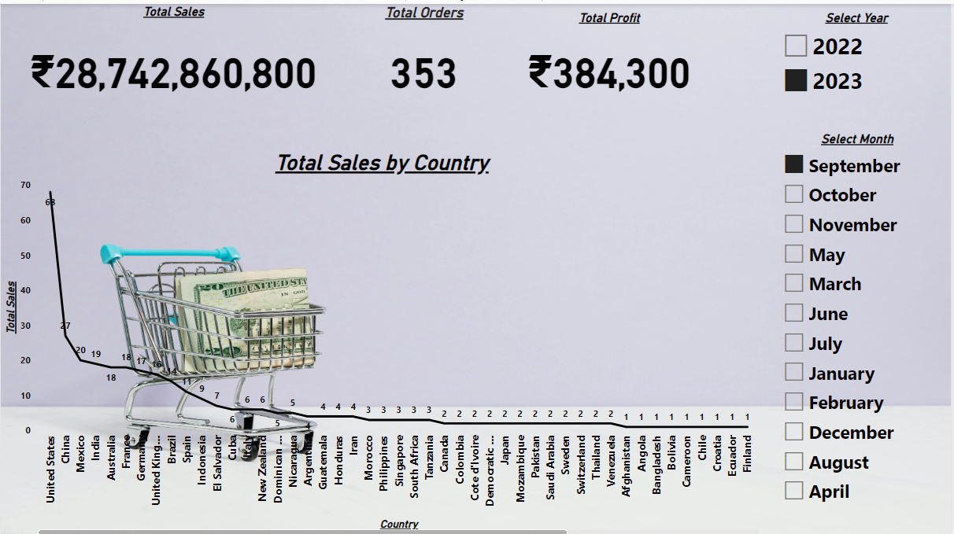
MONTHLY SALES RESULT
HERE IS THE RESULT FOR PREVIOUS VISUAL

Slide 9
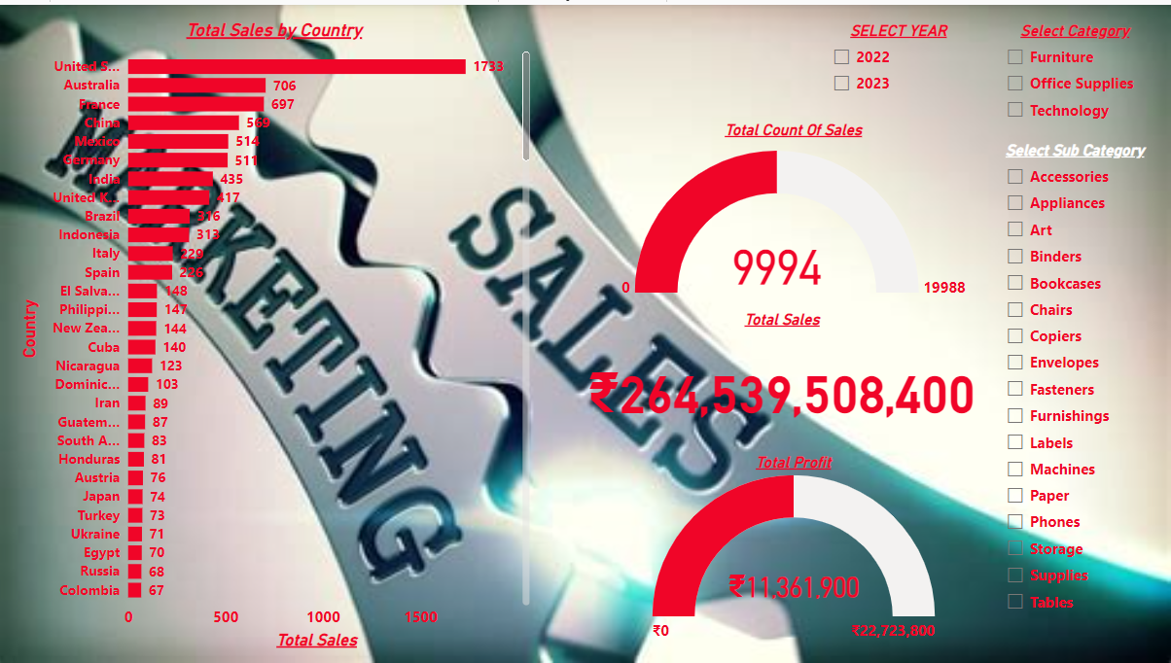
CATEGORY SALES
Category sales analysis focuses on a selected category and year, providing a detailed report that outlines performance across different product categories. This report highlights total sales revenue, profits, and the count of total orders for each category within the chosen region. By examining this data, users can identify high-performing categories, assess market demand, and strategize for future growth opportunities.

Slide 10
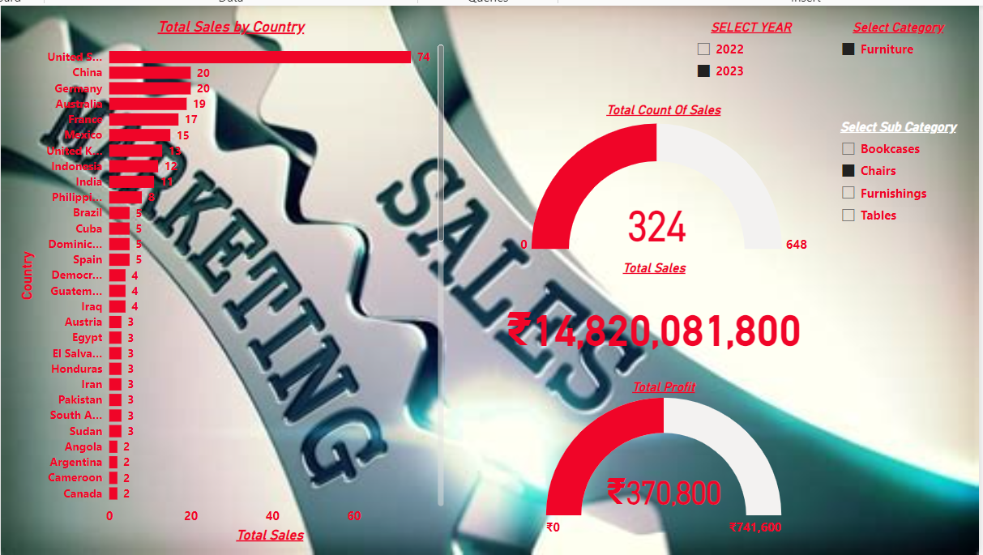
CATEGORY SALES RESULT
HERE IS THE RESULT FOR PREVIOUS VISUAL

Slide 11
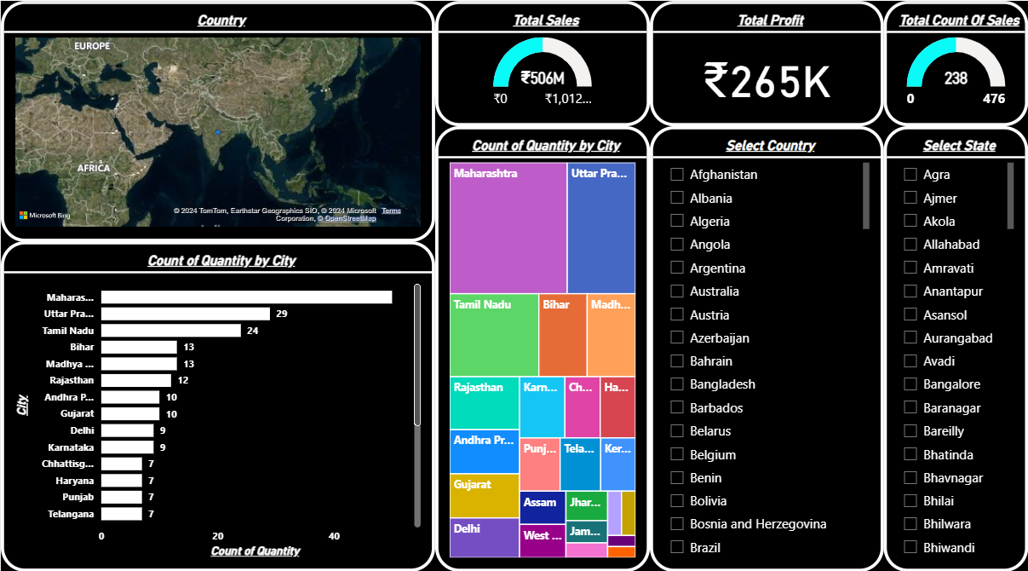
COUNTRY SALES
Country sales analysis involves selecting a specific country and state along with a designated year to generate a detailed report. This report presents key metrics, including total sales revenue, profits, and the count of total orders for that particular country and state. By analyzing this data, users can gain insights into regional performance, identify trends, and develop targeted strategies to enhance sales and profitability.

Slide 12
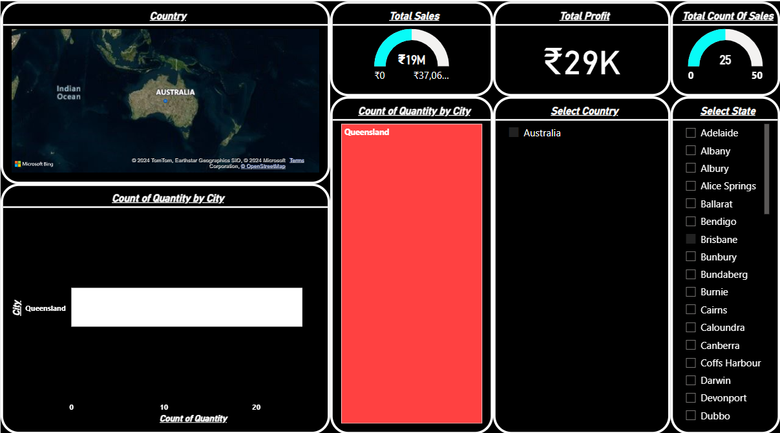
COUNTRY SALES RESULT
HERE IS THE RESULT FOR PREVIOUS VISUAL

Slide 13
CONCLUSION
In conclusion, the comprehensive sales analysis across regions, categories, and countries offers a holistic view of performance for the selected year. By evaluating total sales revenue, profits, and order counts, stakeholders can identify key trends and opportunities for improvement. This project equips decision-makers with the insights necessary to refine strategies, enhance operational efficiency, and drive growth across diverse markets. Ultimately, leveraging this data fosters informed decision-making that can lead to increased profitability and sustained success.

Slide 14
THANK YOU

